Slide 1
Introduction to CUDA Programming
Implementing Reductions
Andreas Moshovos
Winter 2009
Based on slides from:
Mark Harris NVIDIA
Optimizations studied on G80 hardware

Slide 2
Reduction Operations
Multiple values are reduced into a single value
  ADD, MUL, AND, OR, ….
Useful primitive
Easy enough to allow us to focus on optimization techniques
10 | 11 | 12 | 13
46

Slide 3
Sequential Reduction
10
11
21
3
24
7
31
7
38
Start with the first two elements --> partial result
Process the next element
O(N)

Slide 4
Parallel Reduction
Pair-wise reduction in steps – Tree-like
Time
1
10
11
4
5
12
13
1
7
2
21
9
25
8
3
30
33
4
66
log₂ N steps / N amount of work

Slide 5
Parallel Reduction – Different Degree-Trees possible
Pair-wise reduction in steps – Tree-like
Time
1
10
11
4
5
12
13
1
7
2
30
33
3
66
log₄ N steps / N amount of work

Slide 6
CUDA Strategy
Single Block:
  Use Tree-Like approach
Multiple Blocks?
  Not a necessity
    one thread can always process many elements
    But, will suffer from low utilization
  Utilize GPU resources
  Useful for large arrays
Each block processes a portion of the input

Slide 7
How about multiple blocks
How do we communicate results across blocks?
The key problem is synchronization:
  How do we know that each block has finished?
Time

Slide 8
Global Synchronization
If there was such a thing:
Time
sync
sync
wait
wait
sync
sync
wait
Synchronization
achieved

Slide 9
The Problem with Global Synchronization
CUDA does not support it
  One reason:
    it’s expensive to implement
  Another reason:
    “choose” between limited blocks or deadlock
Hardware
Software
blocks
Active Blocks
Waiting to Execute

Slide 10
Deadlock
Waiting for an SM
Time
sync
sync
wait
wait
sync
Never gets here
Synchronization
never
achieved
wait

Slide 11
The Problem with Global Synchronization / Summary
If there was global sync
  Global sync after each block
  Once all blocks are done, continue recursively
CUDA does not have global sync:
  Expensive to support
  Would limit the number of blocks
  Otherwise deadlock will occur
    Once a block gets assigned to an SM it stays there
    Each SM can take only 8 blocks
    So, at most #SMs x 8 blocks could be active at any given point of time
Solution: Decompose into multiple kernels

Slide 12
Decomposing into Multiple Kernels
Implicit Synchronization between kernel invocations
  Overhead of launching a new kernel non-negligible
    Don’t know how much
    Measure it
Time
Kernel #1
sync
sync
sync
Synchronization
achieved
Implicitly
wait
sync
Kernel #2

Slide 13
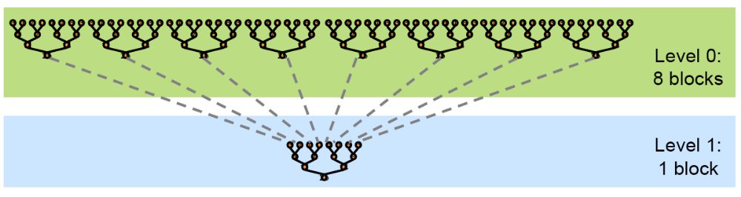
Reduction: Big Picture
The code for all levels is the same
The same kernel code can be called multiple times

Slide 14

Optimization Goal
Get maximum GPU performance
Two components:
  Compute Bandwidth: GFLOPs
  Memory Bandwidth: GB/s

Slide 15
Optimization Goals Cont.
Reductions typically have low arithmetic intensity
  FLOPs/element loaded from memory
So, bandwidth will be the limiter
For the ASUS ENGTX280 OC
  512-bit interface, 1.14GHz DDR3
  512 / 8 x 1.14 x 2 = 145.92 GB/s

Slide 16
Reduction #1: Strategy
Load data:
  Each thread loads one element from global memory to shared memory
Actual Reduction: Proceed in logN steps
  A thread reduces two elements
    The first two elements by the first thread
    The next two by the next thread
    And so, on
  At the end of each step:
    deactivate half of the threads
  Terminate: when one thread left
Write back to global memory

Slide 17
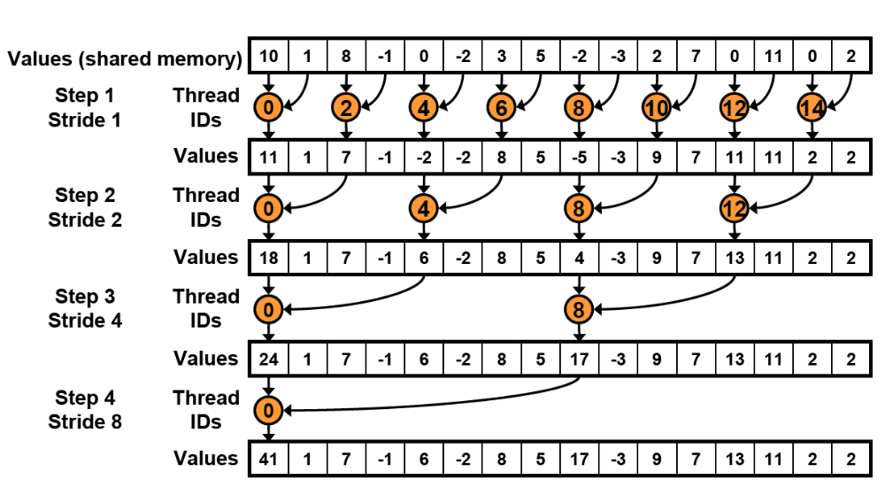
Reduction Steps

Slide 18
Reduction #1 Code: Interleaved Accesses
__global__ void reduce0(int *g_idata, int *g_odata) {
extern __shared__ int sdata[];
// each thread loads one element from global to shared mem
unsigned int tid = threadIdx.x;
unsigned int i = blockIdx.x*blockDim.x + threadIdx.x;
sdata[tid] = g_idata[i];
__syncthreads();
// do reduction in shared mem
for (unsigned int s=1; s < blockDim.x; s *= 2) { // step = s x 2
if (tid % (2*s) == 0) { // only threadIDs divisible by the step participate
sdata[tid] += sdata[tid + s];
}
__syncthreads();
}
// write result for this block to global mem
if (tid == 0) g_odata[blockIdx.x] = sdata[0];
}

Slide 19
Performance for kernel #1
 | Time (2²² ints) | Bandwidth
Kernel 1: interleaved addressing with divergent branching | 8.054 ms | 2.083 GB/s
Note: Block size = 128 for all experiments
Bandwidth calculation:
Each block processes 128 elements and does:
128 reads & 1 write
We only care about global memory
At each kernel/step:
N (element reads) + N / 128 (element writes)
Every kernel/step reduces input size by 128x
next set N = N / 128
So for:
N = 4194304
Accesses = 4227394
Each access is four bytes
Caveat:
results are for a G80
processor

Slide 20
Reduction #1 code: Interleaved Accesses
__global__ void reduce0 (int *g_idata, int *g_odata) {
extern __shared__ int sdata[];
// each thread loads one element from global to shared mem
unsigned int tid = threadIdx.x;
unsigned int i = blockIdx.x*blockDim.x + threadIdx.x;
sdata[tid] = g_idata[i];
__syncthreads();
// do reduction in shared mem
for (unsigned int s=1; s < blockDim.x; s *= 2) {
if (tid % (2*s) == 0) {
sdata[tid] += sdata[tid + s];
}
__syncthreads();
}
// write result for this block to global mem
if (tid == 0) g_odata[blockIdx.x] = sdata[0];
}
Highly divergent code
leads to very poor
performance

Slide 21
Divergent Branching: Warp Control Flow
4 warps/step

Slide 22
Divergent Branching: Warp Control Flow

Slide 23
Reduction #2: Interleaved Addr./non-divergent branching
Replace the divergent branching code:
// do reduction in shared mem
for (unsigned int s=1; s < blockDim.x; s *= 2) {
if (tid % (2*s) == 0) {
sdata[tid] += sdata[tid + s];
}
__syncthreads();
}
With strided index and non-divergent branch
// do reduction in shared mem
for (unsigned int s=1; s < blockDim.x; s *= 2) {
int index = 2 * s * tid;
if (index < blockDim.x == 0) {
sdata[index] += sdata[index + s];
}
__syncthreads();
}

Slide 24
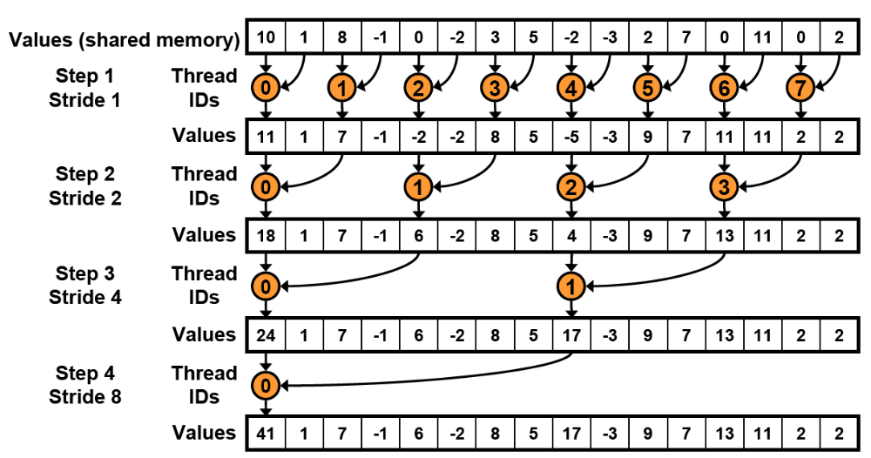
Reduction #2: Access Pattern

Slide 25
Reduction #2: Warp control flow
4 warps/step

Slide 26
Reduction #2: Warp control flow

Slide 27
Performance for 4M element reduction
 | Time (2²² ints) | Bandwidth | Step Speedup | Cumulative Speedup
Kernel 1: interleaved addressing with divergent branching | 8.054 ms | 2.083 GB/s
Kernel 2: interleaved addressing non-divergent branching | 3.456 ms | 4.854 GB/s | 2.33x | 2.33x

Slide 28
Reduction #2: Problem
2-way
2-way
2-way
none
2-way bank conflicts at every step
Recall there are more than 16 threads
To see the conflicts see what happens with 128 threads

Slide 29
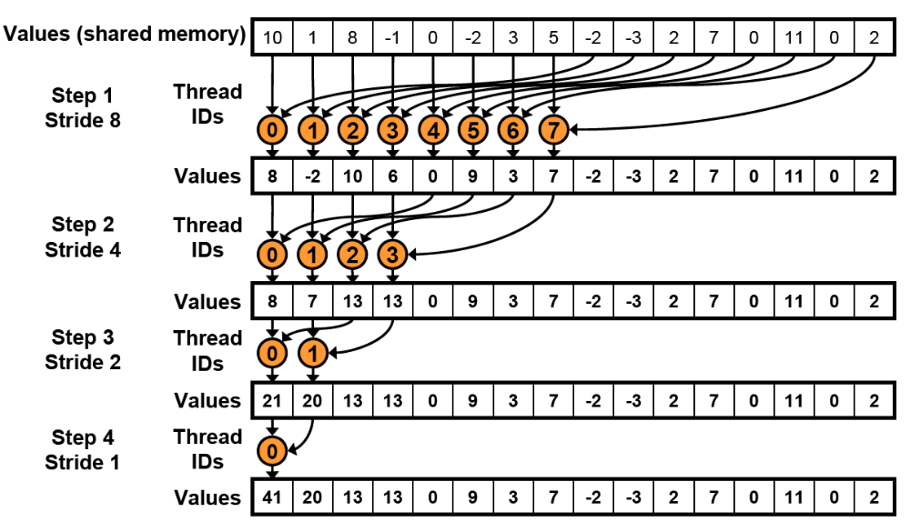
Reduction #3: Sequential Accesses
Eliminates bank conflicts

Slide 30
Reduction #3: Code Changes
Replace stride indexing in the inner loop:
// do reduction in shared mem
for (unsigned int s=1; s < blockDim.x; s *= 2) {
int index = 2 * s * tid;
if (index < blockDim.x == 0) {
sdata[index] += sdata[index + s];
}
__syncthreads();
}
With reversed loop and threadID-based indexing:
// do reduction in shared mem
for (unsigned int s = blockDim.x/2; s > 0; s /= 2) {
if (tid < s) {
sdata[tid] += sdata[tid + s];
}
__syncthreads();
}

Slide 31
Performance for 4M element reduction
 | Time (2²² ints) | Bandwidth | Step Speedup | Cumulative Speedup
Kernel 1: interleaved addressing with divergent branching | 8.054 ms | 2.083 GB/s
Kernel 2: interleaved addressing non-divergent branching | 3.456 ms | 4.854 GB/s | 2.33x | 2.33x
Kernel 3: sequential addressing | 1.722 ms | 9.741 GB/s | 2.01x | 4.68x

Slide 32
Reduction #3: Bad resource utilization
All threads read one element
First step: half of the threads are idle
Next step: another half becomes idle
// do reduction in shared mem
for (unsigned int s = blockDim.x/2; s > 0; s /= 2) {
if (tid < s) {
sdata[tid] += sdata[tid + s];
}
__syncthreads();
}

Slide 33
Reduction #4: Read two elements and do the first step
Original: Each thread reads one element
// each thread loads one element from global to shared mem
unsigned int tid = threadIdx.x;
unsigned int i = blockIdx.x*blockDim.x + threadIdx.x;
sdata[tid] = g_idata[i];
__syncthreads();
Read two and do the first reduction step:
// each thread loads two elements from global to shared mem
// end performs the first step of the reduction
unsigned int tid = threadIdx.x;
unsigned int i = blockIdx.x* blockDim.x * 2 + threadIdx.x;
sdata[tid] = g_idata[i] + g_idata[i + blockDim.x];
__syncthreads();

Slide 34
Performance for 4M element reduction
 | Time (2²² ints) | Bandwidth | Step Speedup | Cumulative Speedup
Kernel 1: interleaved addressing with divergent branching | 8.054 ms | 2.083 GB/s
Kernel 2: interleaved addressing non-divergent branching | 3.456 ms | 4.854 GB/s | 2.33x | 2.33x
Kernel 3: sequential addressing | 1.722 ms | 9.741 GB/s | 2.01x | 4.68x
Kernel 4: first step during global load | 0.965 ms | 17.377 GB/s | 1.78x | 8.34x

Slide 35
Reduction #4: Still way off
Memory bandwidth is still underutilized
  We know that reductions have low arithmetic density
What is the potential bottleneck?
  Ancillary instructions that are not loads, stores, or arithmetic for the core computation
  Address arithmetic and loop overhead
Unroll loops to eliminate these “extra” instructions

Slide 36
Unrolling the last warp
At every step the number of active threads halves
  When s <=32 there is only one warp left
Instructions are SIMD-synchronous within a warp
  They all happen in lock step
  No need to use __syncthreads()
  We don’t need “if (tid < s)” since it does not save any work
    All threads in a warp will “see” all instructions whether they execute them or not
Unroll the last 6 iterations of the inner loop
  s <= 32

Slide 38
Reduction #2: Warp control flow
4 warps/step
// do reduction in shared mem
for (unsigned int s = blockDim.x/2; s > 0; s /= 2) {
if (tid < s) {
sdata[tid] += sdata[tid + s];
}
__syncthreads();
}

Slide 39
Reduction #5: Unrolling the last 6 iterations
// do reduction in shared mem
for (unsigned int s = blockDim.x/2; s > 32; s /= 2) {
if (tid < s) {
sdata[tid] += sdata[tid + s];
}
__syncthreads();
}
if (tid <32)
{
sdata[tid] += sdata[tid + 32];
sdata[tid] += sdata[tid + 16];
sdata[tid] += sdata[tid + 8];
sdata[tid] += sdata[tid + 4];
sdata[tid] += sdata[tid + 2];
sdata[tid] += sdata[tid + 1];
}
This saves work in all warps not just the last one
  Without unrolling all warps execute the for loop and if statement

Slide 40
Unrolling the Last Warp: A closer look
Keep in mind:
#1: Warp execution proceeds in lock step for all threads
  All threads execute the same instruction
  So:
    sdata[tid] += sdata[tid + 32];
  Becomes:
    Read into a register: sdata[tid]
    Read into a register: sdate[tid+32]
    Add the two
    Write: sdata[tid]
#2: Shared memory can provide up to 16 words per cycle
  If we don’t use this capability it just gets wasted

Slide 41
Unrolling the Last Warp: A Closer Look
sdata[tid] += sdata[tid + 32];
Element
index
0
31
32
63
0
15
31
threadID
0
31
All threads doing useful work

Slide 42
Unrolling the Last Warp: A Closer Look
sdata[tid] += sdata[tid + 16];
  Half of the threads, 16-31, are doing useless work
  At the end they “destroy” elements 16-31
  Elements 16-31 are inputs to threads 0-14
  But threads 0-15 read them before they get written by threads 16-31
    All reads proceed in “parallel” first
    All writes proceed in “parallel” last
  So, no correctness issues
  But, threads 16-31 are doing useless work
    The units and bandwidth are there → no harm (only power)
0
31
32
0
15
20
31
threadID
0
31

Slide 43
Unrolling the Last Warp: A Closer Look
0
31
32
0
7
20
31
threadID
0
31
0
31
32
0
3
20
31
0
31

Slide 44
Unrolling the Last Warp: A Closer Look
0
31
32
1
0
20
31
0
31
32
0
20
31
0
31

Slide 45
Performance for 4M element reduction
 | Time (2²² ints) | Bandwidth | Step Speedup | Cumulative Speedup
Kernel 1: interleaved addressing with divergent branching | 8.054 ms | 2.083 GB/s
Kernel 2: interleaved addressing non-divergent branching | 3.456 ms | 4.854 GB/s | 2.33x | 2.33x
Kernel 3: sequential addressing | 1.722 ms | 9.741 GB/s | 2.01x | 4.68x
Kernel 4: first step during global load | 0.965 ms | 17.377 GB/s | 1.78x | 8.34x
Kernel 5: Unroll last warp | 0.536 ms | 31.289 GB/s | 1.8x | 15.01x

Slide 46
Reduction #6: Complete Unrolling
If we knew the number of iterations at compile time, we could completely unroll the reduction
  Block size is limited to 512
  We can restrict our attention to powers-of-two block sizes
We can easily unroll for a fixed block size
  But we need to be generic
  How can we unroll for block sizes we don’t know at complile time?
C++ Templates
  CUDA supports C++ templates on device and host functions

Slide 47
Unrolling Using Templates
Specify block size as a function template parameter:
  template <unsigned int blockSize>
  __global__ void reduce5(int *g_data, int *g_odata)

Slide 48
Reduction #6: Completely Unrolled
if (blockSize >= 512) {
if (tid < 256) { sdata[tid] += sdata[tid + 256]; } __syncthreads();
}
if (blockSize >= 256) {
if (tid < 128) { sdata[tid] += sdata[tid + 128]; } __syncthreads();
}
if (blockSize >= 128) {
if (tid < 64) { sdata[tid] += sdata[tid + 64]; } __syncthreads();
}
if (tid < 32) {
if (blockSize >= 64) sdata[tid] += sdata[tid + 32];
if (blockSize >= 32) sdata[tid] += sdata[tid + 16];
if (blockSize >= 16) sdata[tid] += sdata[tid + 8];
if (blockSize >= 8) sdata[tid] += sdata[tid + 4];
if (blockSize >= 4) sdata[tid] += sdata[tid + 2];
if (blockSize >= 2) sdata[tid] += sdata[tid + 1];
}
Note: all code in RED will be evaluated at compile time.
Results in a very efficient inner loop

Slide 49
What if block size is not known at compile time?
There are “only” 10 possibilities:
  switch (threads)
  {
  case 512:
  reduce5<512><<< dimGrid, dimBlock, smemSize >>>(d_idata, d_odata); break;
  case 256:
  reduce5<256><<< dimGrid, dimBlock, smemSize >>>(d_idata, d_odata); break;
  case 128:
  reduce5<128><<< dimGrid, dimBlock, smemSize >>>(d_idata, d_odata); break;
  case 64:
  reduce5< 64><<< dimGrid, dimBlock, smemSize >>>(d_idata, d_odata); break;
  case 32:
  reduce5< 32><<< dimGrid, dimBlock, smemSize >>>(d_idata, d_odata); break;
  case 16:
  reduce5< 16><<< dimGrid, dimBlock, smemSize >>>(d_idata, d_odata); break;
  case 8:
  reduce5< 8><<< dimGrid, dimBlock, smemSize >>>(d_idata, d_odata); break;
  case 4:
  reduce5< 4><<< dimGrid, dimBlock, smemSize >>>(d_idata, d_odata); break;
  case 2:
  reduce5< 2><<< dimGrid, dimBlock, smemSize >>>(d_idata, d_odata); break;
  case 1:
  reduce5< 1><<< dimGrid, dimBlock, smemSize >>>(d_idata, d_odata); break;
  }

Slide 50
Performance for 4M element reduction
 | Time (2²² ints) | Bandwidth | Step Speedup | Cumulative Speedup
Kernel 1: interleaved addressing with divergent branching | 8.054 ms | 2.083 GB/s
Kernel 2: interleaved addressing non-divergent branching | 3.456 ms | 4.854 GB/s | 2.33x | 2.33x
Kernel 3: sequential addressing | 1.722 ms | 9.741 GB/s | 2.01x | 4.68x
Kernel 4: first step during global load | 0.965 ms | 17.377 GB/s | 1.78x | 8.34x
Kernel 5: Unroll last warp | 0.536 ms | 31.289 GB/s | 1.8x | 15.01x
Kernel 6: Complete Unroll | 0.381 ms | 43.996 GB/s | 1.41x | 21.16x

Slide 51
Can we improve?
O(N/P)
copy data
If we can choose P --> can we make this O(log N)
O(log N)
reduce

Slide 52
Can we improve?
Two parts:
  Loading elements + pair-wise reduction
    O(N/P)
  Tree-like reduction
    O(log N)
Overall: O(N/P + log N)
Can we make the O(N/P) part O(log N)?
What should be P?
  N/log N
So, first step should be:
  load N/log N elements
  do the first N/log reductions

Slide 53
Brent’s theorem
t_{p} <= t + (W – t) / p
t_{p} <= 6 + (10 – 6) / 2 = 8
W
t
t_{p} = 8
W = 10 t = 6 p >= 3
If given infinite processors an algorithm takes t steps
then given p processors it should take at most t_{p} steps

Slide 54
Can we improve the algorithm?
Work or “element complexity”: W
  total number of operations performed collectively by all processors
  Time to execute on a single processor
Time Step: All operations that have no unresolved dependencies are performed in parallel
Depth or “step complexity”: t
  time to complete all time steps
  time to execute if we had infinite processors
Computation time on P Processors: t_{p}
  time to execute when there are P processors

Slide 55
Brent’s Theorem
t_{p} <= t + (W – t) / p
p =1, t_{p} = W (seq. algorithm)
p→ inf, t_{p} → t (limit)
if sequential --> t = W
Work or “element complexity”: W
Depth or “step complexity”: t
Computation time on P Processors: t_{p}

Slide 56
What is Brent’s theorem useful for?
Tells us whether an algorithm can be improved for sure
Example:
  summing the elements of an array
    for (i=0; i < N); i++) sum = sum + a[i];
    W = N, t = N
    t_{p} = N + (N – N) / p = N
    No matter what, this will take N time

Slide 57
Brent’s theorem example application
Summing the elements recursively
  ((a[0] + a[1]) + ((a[2] + a[3])) …
  t = log N
  W = N
T = log(N) + (N - log(N))/p
Conclusions:
  No implementation can run faster than O(log N).
  Given N processors, there is an algorithm of log N time
  Given N / log N processors, there is an algorithm of ~2 x log N = O(log N) time
  Given 1 processor, there is an algorithm that takes N time

Slide 58
Brent’s theorem contd.
Cost: P x Time Complexity
  P = 1 x O(N) time
  P = log N x O(log N) time
  P = N x O(log N) time
  The implementations with 1 or log N processors, therefore are cost optimal,
  The implementation with N processors is not.
It is important to remember that Brent's theorem does not tell us how to implement any of these algorithms in parallel
  it merely tells us what is possible
  The Brent's theorem implementation may be hideously ugly compared to the naive implementation

Slide 59
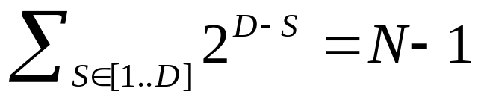
Parallel Reduction Complexity
Log(N) parallel steps, each step S does N/2^{S} independent operations
  Step Complexity: O(log N)
For N=2^{D}, performs operations
  Work Complexity is O(N) – it is work-efficient
  Does not perform more operations than a sequential algorithm
With P threads physically in parallel (P processors), time complexity is O(N/P + log N)
  N/P for global to shared
  log N for the calculations
  Compare to O(N) for sequential reduction

Slide 60
What about Cost?
Cost of parallel algorithm
  Processors x Time Complexity
    Allocate threads instead of processors: O(N) threads
    Time complexity is O(log N), so cost is O(N log N)
      Not cost efficient
Brent’s theorem suggests O(N/log N) threads
  Each thread does O(log N) sequential work
  Then all O(N/log N) threads cooperate for O(log N) steps
  Cost = O((N/log N) * log N) = O(N) → cost efficient
Sometimes called algorithm cascading
  Can lead to significant speedups in practice

Slide 61
Algorithm Cascading
Combine sequential and parallel reduction
  Each thread loads and sums multiple elements into shared memory
  Tree-based reduction in shared memory
Brent’s theorem says each thread should sum O(log N) elements
  i.e., 1024 to 2048 elements per block vs. 256
In Mike Harris’ experience, beneficial to push it even further
  Possibly better latency hiding with more work per thread
  More threads per block reduces levels in tree of recursive kernel invocations
  High kernel launch overhead in last levels with few blocks
On G80, best perf with 64-256 blocks of 128 threads
  1024-4096 elements per thread

Slide 62
Reduction #7: Multiple Adds / Thread
Replace load and add two elements
// each thread loads two elements from global to shared mem
// end performs the first step of the reduction
unsigned int tid = threadIdx.x;
unsigned int i = blockIdx.x* blockDim.x * 2 + threadIdx.x;
sdata[tid] = g_idata[i] + g_idata[i + blockDim.x];
__syncthreads();
With a loop to add as many as necessary
unsigned int tid = threadIdx.x;
unsigned int i = blockIdx.x * blockSize * 2 + threadIdx.x;
unsigned int gridSize = blockSize * 2 * gridDim.x;
sdata[tid] = 0;
while (i < n) {
sdata[tid] += g_idata[i] + g_idata[i + blockSize];
i += gridSize;
}
__syncthreads();
gridSize steps to achieve coalescing

Slide 63
Performance for 4M element reduction
 | Time (2²² ints) | Bandwidth | Step Speedup | Cumulative Speedup
Kernel 1: interleaved addressing with divergent branching | 8.054 ms | 2.083 GB/s
Kernel 2: interleaved addressing non-divergent branching | 3.456 ms | 4.854 GB/s | 2.33x | 2.33x
Kernel 3: sequential addressing | 1.722 ms | 9.741 GB/s | 2.01x | 4.68x
Kernel 4: first step during global load | 0.965 ms | 17.377 GB/s | 1.78x | 8.34x
Kernel 5: Unroll last warp | 0.536 ms | 31.289 GB/s | 1.8x | 15.01x
Kernel 6: Complete Unroll | 0.381 ms | 43.996 GB/s | 1.41x | 21.16x
Kernel 7: multiple elements per thread | 0.268 ms | 62.671 GB/s | 1.42x | 30.04x

Slide 64
Final Optimized Kernel
template <unsigned int blockSize>
__global__ void reduce6(int *g_idata, int *g_odata, unsigned int n)
{
__shared__ int sdata[];
unsigned int tid = threadIdx.x;
unsigned int i = blockIdx.x*(blockSize*2) + tid;
unsigned int gridSize = blockSize*2*gridDim.x;
sdata[tid] = 0;
do { sdata[tid] += g_idata[i] + g_idata[i+blockSize]; i += gridSize; } while (i < n);
__syncthreads();
if (blockSize >= 512) { if (tid < 256) { sdata[tid] += sdata[tid + 256]; } __syncthreads(); }
if (blockSize >= 256) { if (tid < 128) { sdata[tid] += sdata[tid + 128]; } __syncthreads(); }
if (blockSize >= 128) { if (tid < 64) { sdata[tid] += sdata[tid + 64]; } __syncthreads(); }
if (tid < 32) {
if (blockSize >= 64) sdata[tid] += sdata[tid + 32];
if (blockSize >= 32) sdata[tid] += sdata[tid + 16];
if (blockSize >= 16) sdata[tid] += sdata[tid + 8];
if (blockSize >= 8) sdata[tid] += sdata[tid + 4];
if (blockSize >= 4) sdata[tid] += sdata[tid + 2];
if (blockSize >= 2) sdata[tid] += sdata[tid + 1];
}
if (tid == 0) g_odata[blockIdx.x] = sdata[0];
}

Slide 65
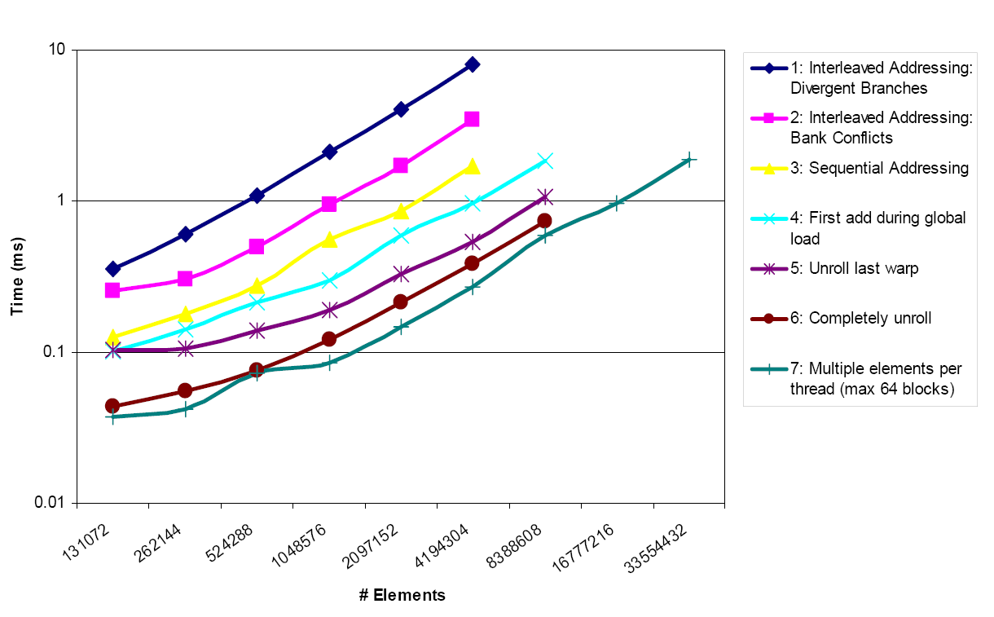
Performance comparison on G80

Slide 66
Optimization types
Algorithmic optimizations
  Changes to addressing, algorithm cascading
  11.84x speedup
Code optimizations:
  Loop unrolling
  2.54x speedup

Slide 67
Summary
Understand CUDA performance characteristics
  Memory coalescing
  Divergent branching
  Bank conflicts
  Latency hiding
Use peak performance metrics to guide optimization
Understand parallel algorithm complexity theory
Know how to identify type of bottleneck
  e.g., memory, core computation, or instruction overhead
Optimize your algorithm, then unroll loops
Use template parameters to generate optimal code

